Slide 1
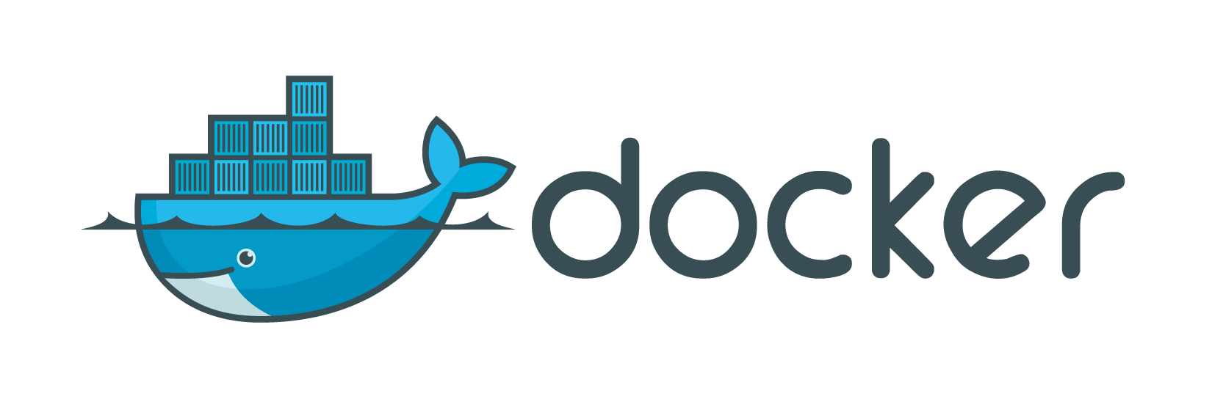
A Brief Guide to Containerizing Your Life
By: Wesley Martin

Slide 2

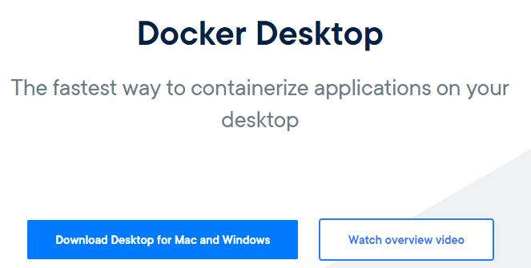
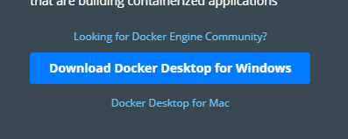
Annoying Upfront Work
Go to docker.com
Unfortunately you will need an account
Once you have signed in, you will need to download docker desktop
Notes:
Write important stuff on board

Slide 3
What is Docker?
Kernel Space vs. User Space
What is virtual machine?
What is a container?
Notes:
Before we can move on to Docker we first need to set the scene.
Virtualization has been around for decades https://linuxacademy.com/blog/linux-academy/history-of-container-technology/
Isolation of different computers running off common host existed in the 60s
And actually first, anyone who wants to follow along whou

Slide 4
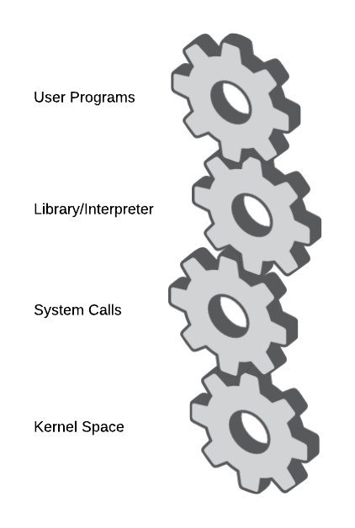
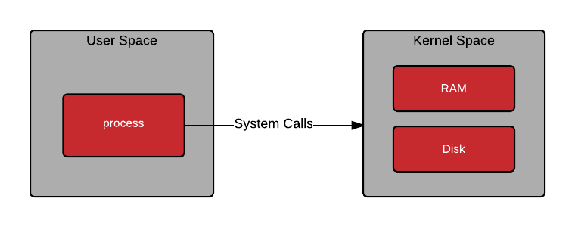
Kernel Space vs. User Space (Slightly Simplified)
Kernel Space
Abstraction layer for hardware and raw resources
Linux Kernel
Operating systems built to run on specific kernel
User Space
All code that is not in the kernel
Communicate with Kernel through various APIs
Notes:
Kernel interacts with hardware for us, and we interact with

Slide 5
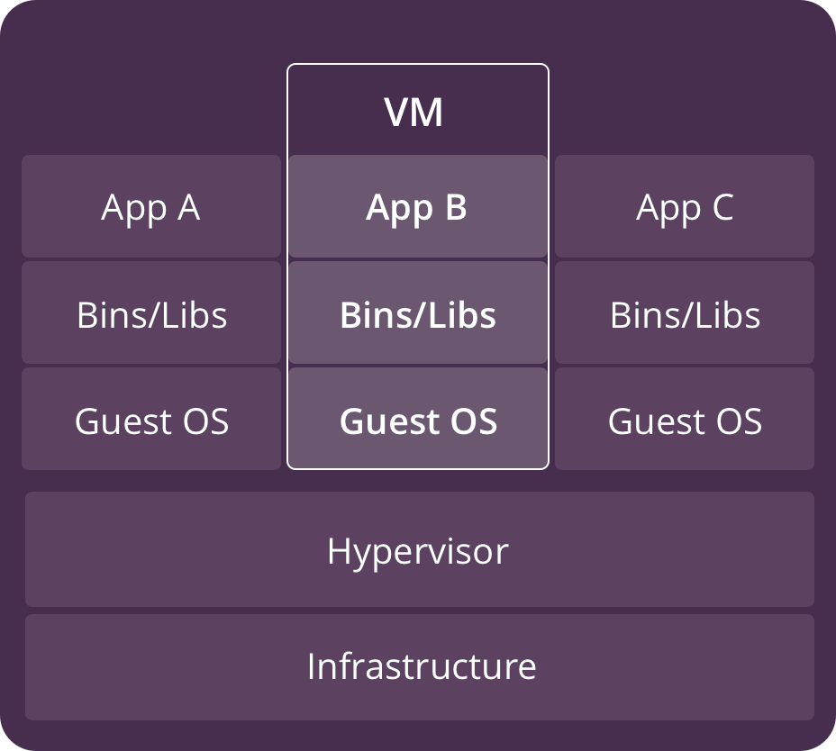
Virtual Machines (Again, Slightly Simplified)
Each has its own operating system and kernel
Run apps on VM Operating system
Generally quite large, take time to spin up
Take lots of resources, challenging to manage
https://www.backblaze.com/blog/wp-content/uploads/2018/06/vms.png
Notes:
All of us have used them
They are great for simulating a full computer
They have full access to virtualized hardware

Slide 6
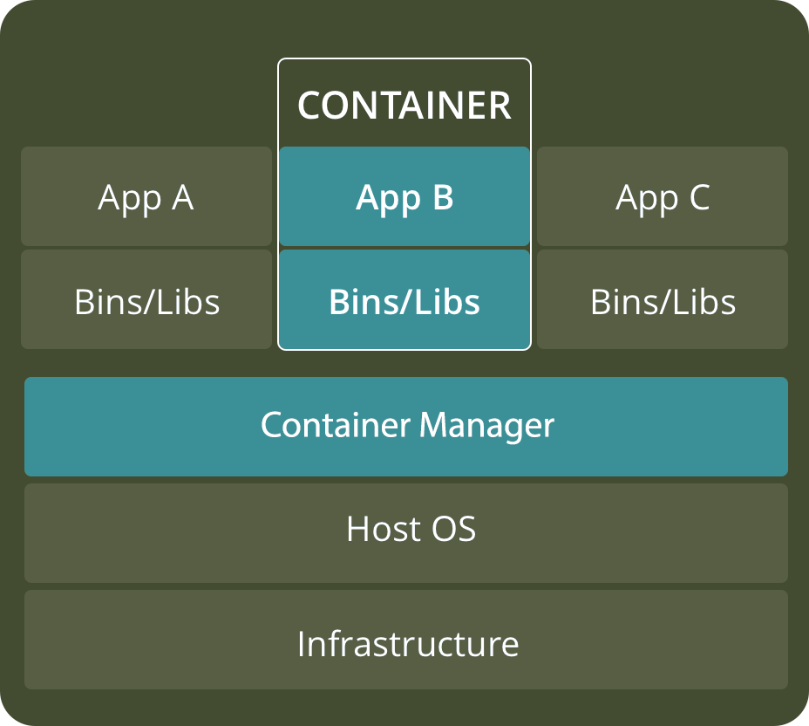
Containers
A way of setting up an isolated user space with direct access to the host kernel
Can access the host operating system and all its libraries
Most famous is the Linux container (LXC)
https://www.backblaze.com/blog/wp-content/uploads/2018/06/containers.png
Notes:
Based on a related, but different concept to that of virtual machines

Slide 7
When to use Which
Virtual Machine
Deployment Testing
Development
Monolithic Architecture
Containers
Microservice Architecture
Service Scaling
Fast up/down time
Orchestration
Notes:
It really depends
Generally speaking, nowadays, there is rarely a time when you can’t use a container. They are fast, efficient, and scale well. A single service works great in a container, a set of related services can work well in side by side containers. More niche projects, or when a service needs fine grained interactions with a host, may require VMs
NOTE: Check in with installation

Slide 8
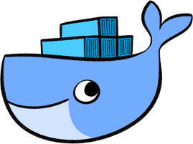
The Whale in the Room
Notes:
Now for the whale in the room…
What is Docker?

Slide 9
What is Docker?
A platform which, amongst other things, manages images and containers
Docker has two main components, Docker Hub and the Docker Engine
Image
A chunk of software which was created and added to Docker as a way to create a container
Created using a dockerfile
Ubuntu, Redis, Mysql, rails, nginx etc.
Docker Container
An instance of an image
Created based off the specified image, and then given access to the host kernel
Notes:
Docker keeps track of all the images you have on your system
Allows you to create instances of images at will, which are containers

Slide 10
Installation on Linux
Setup the Image Repository
// Remove old versions sudo apt-get remove docker docker-engine docker.io containerd runc
// Update Apt get sudo apt-get update
// Install the packages to access the repository sudo apt-get install apt-transport-https ca-certificates curl gnupg-agent software-properties-common
// Install docker security key curl -fsSL https://download.docker.com/linux/ubuntu/gpg | sudo apt-key add -
// Verify the key exists and matches 9DC8 5822 9FC7 DD38 854A E2D8 8D81 803C 0EBF CD88 sudo apt-key fingerprint 0EBFCD88
// Install the stable repository sudo add-apt-repository "deb [arch=amd64] https://download.docker.com/linux/ubuntu $(lsb_release -cs) stable"

Slide 11
Installation on Linux
Setup the Docker Engine
// Update Apt get sudo apt-get update
// Install latest version of docker engine sudo apt-get install docker-ce docker-ce-cli containerd.io
// Verify it worked sudo docker run hello-world
Notes:
Do this depending how much time you have

Slide 12
Docker Hub
A repository of images which can be accessed using
Custom images can also be made and pushed to the Docker Hub repository
Similar in concept to GitHub
docker pull [image]
docker push [image]

Slide 13
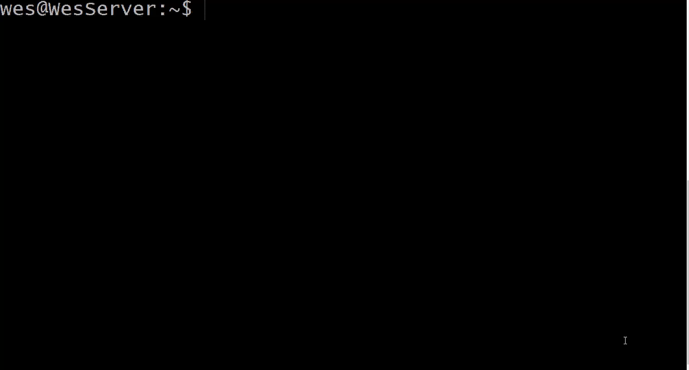
Pulling and Running a Docker Image
Notes:
Just in case you can’t access linux to test it
Docker checks to see if whalesay exists locally, and finds it doesn’t
It then checks online in DockerHub, and finds that it does exist
From there, it pulls down whalesay and adds it to the local library
I then run docker image to see the list of images
I then startup a container using that image, and it runs

Slide 14
Docker on Windows
How does Docker on windows work?
Recall that Docker needs to access the kernel, and can only work with the Linux kernel
Docker Host for Windows does not run natively on Windows, but rather installs Linux as a virtual machine and runs on that
All the leg work is hidden within Docker Desktop
Notes:
For the rest of this presentation, we will be working with Docker on windows

Slide 15
Installation on Windows
Go to Docker Hub and create an account or login
Click the link to download Docker Desktop
It is large and may take some time
Run the installer
Launch Docker Desktop and Login
Ready to go!

Slide 16
Running Your First Container
Going to pull and run the same whalesay test image
We can see a list of all locally installed images
Finally we can run the image
Note that pull and run can be combined into one
docker pull docker/whalesay
docker images
docker run docker/whalesay cowsay “hello world”

Slide 17
Ok.. So What?
It looks simple, but a lot just happened
Whalesay is an image from the docker account on docker hub, docker had to look locally, and on not finding it, look online to find that image
Created a new container using that image
Setup a file system and access layer
Setup a network interface and IP address
More on this later
And then run the whalesay program
I also used docker images to view all images downloaded on the local system
Notes:
It looks really simple, but a lot just happened

Slide 18
A Closer Look at Dockers CLI
docker run --rm -i -p 800:80 strm/helloworld-http
Startup a simple container that runs in the background
View all running containers
View all running and previously run containers
Note that whalesay does not show up as currently running
We can see some details about each container there are many more details to be seen
Note how each container has a name and an ID
docker ps
docker ps -a
docker inspect [name|id]
Notes:
docker run --rm -i -p 800:80 strm/helloworld-http
Demo it
The container only lasts as long as the process running inside it, so as soon as that process ends, so does the container
The whalesay container ends as soon as it displays the whale
A simple web server however will stay around
The name is randomly generated, and the ID only needs the first 5 characters or so to refer to it

Slide 19
Managing Containers
It can be easy to lose track of running or dormant containers
To stop a container, use
To remove a container completely use
To remove an image use
To attach to a container that is already running
docker stop [name|id]
docker rm [name|id]
docker rmi [name|id]
docker attach [name|id]
Notes:
Note RMI rather than RM

Slide 20
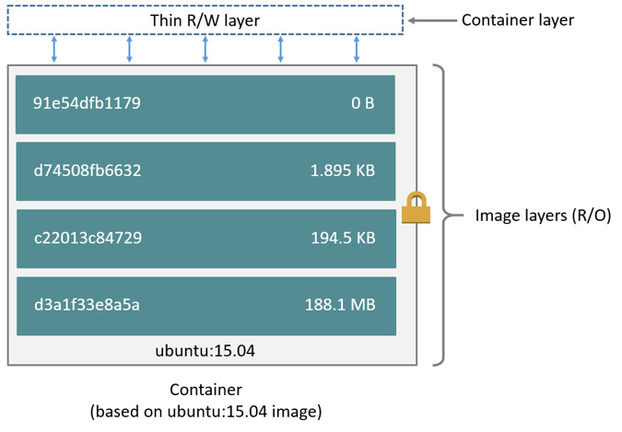
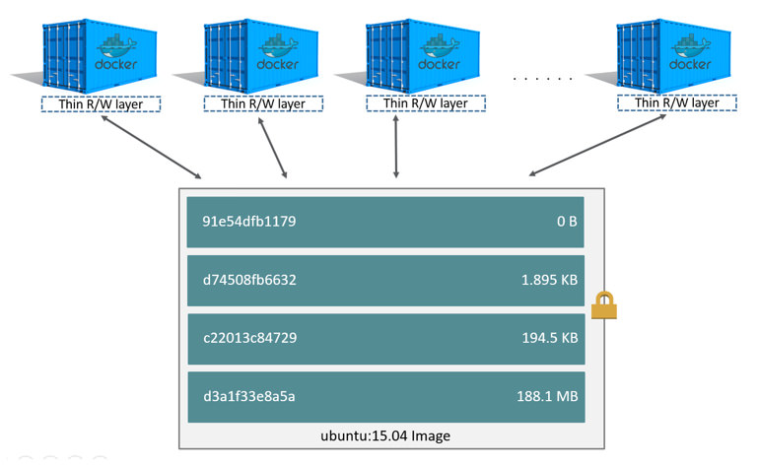
More About Docker Images
Easily confused with containers for those just starting out
Simply put, a docker image is a series of layers, each built on the last.
When an container is made based off an image, it can interact with the ‘top layer’ of that image
The layers in a docker image are each added on top based off an instruction from a dockerfile
The dockerfile is essentially a recipe used to build the image
Notes:
I’ve referred often to docker images, but what exactly are they?
Its hard to introduce images if you don’t know about docker files, and vice versa, but just bear with me

Slide 21
The Dockerfile
Built on a series of INSTRUCTIONS argument, below are some common ones
FROM
Every single Dockerfile must start with a FROM instruction, this indicates which image this new image will inherit from
RUN
Runs a command on that image, such as apt-get, or mkdir
COPY
Used to copy from the host machine into the image
CMD
Specifies which commands will be passed to the default entrypoint
Notes:
Every single docker image has a parent image, which it is built on. Ubuntu is a frequent one, and then functionality is added on top of that
FROM scratch indicates a brand new image tree
NOTE: Parameters passed to the docker run are automatically passed to the last CMD written in the file

Slide 22
More on Dockerfile
Docker build [dockerfile path] –t [image name]
// This image starts off as ubuntu 15.04
FROM ubuntu:15.04
// Copies the local directory on the host to /app on the image
COPY . /app
// Makes whatever application was copied in
RUN make /app
// Starts up python, feeding in the app.py script
CMD python /app/app.py
Notes:
Every layer is cahced, so if you rebuild the image, it will save the last changed lines

Slide 23
Concerning Parameters, CMD and ENTRYPOINT
ENTRYPOINT specifies the application which will be run on startup
Some images, such as ubuntu, have default entrypoints
CMD specifies which arguments will be passed to that entrypoint
Command line arguments given to docker run will override the CMD arguments
FROM ubuntu
CMD echo “hello world”
Notes:
This was annoyingly confusing at first
Note: Pull ubuntu and run it with some commands

Slide 24
Networking in Docker Containers
Every single container is given its own IP Address
Docker creates an internal network which allows all the containers to reach each other
To get access from the host machine, simply map the ports when you execute docker run
Docker run –p [host port]:[container port] [image name]

Slide 25
The Dockerfile
# Pulls the parent ubuntu image
FROM ubuntu:latest
# Runs apt-get update (this is often bad practice,
# see dockers article on best practices)
RUN apt-get update
# Need to ensure python and pip are present and updates
RUN apt-get -y install python
RUN apt-get -y install python-pip
# Now we need to install Flask, which will be used to run the webserver
RUN pip install flask
RUN mkdir -p /opt/source-code/templates
# Now we need to copy in the code that we need
COPY index.py /opt/source-code
COPY templates/index.html /opt/source-code/templates
ENTRYPOINT FLASK_APP=/opt/source-code/index.py flask run --host=0.0.0.0

Slide 26
The Python File
import os
from flask import Flask
from flask import render_template
app = Flask(__name__, template_folder='./templates')
@app.route('/')
def hello_world():
name = os.environ.get("MAIN_TEXT")
color = os.environ.get("COLOR")
print(color)
print(name)
return render_template('index.html', name=name, color=color)

Slide 27
The HTML File
<!doctype html>
<title>Hello from Flask</title>
<style>
body {
{% if color %}
background-color:{{ color }}
{% else %}
background-color:red
{% endif %}
}
</style>
{% if name %}
<h1>Hello {{ name }}!</h1>
{% else %}
<h1>Hello, World!</h1>
{% endif %}

Slide 28
References
KodeKloud. “Docker Tutorial for Beginners - A Full DevOps Course on How to Run Applications in Containers.” YouTube, 16 Aug. 2019, github.com/MarinaVojnovic/HybridLibrary/issues/30.
Bauer, Roderick. “What's the Diff: VMs vs Containers.” Backblaze Blog | Cloud Storage & Cloud Backup, 27 Aug. 2019, www.backblaze.com/blog/vm-vs-containers/.
EllMarquezAuthor, and Name *. “The History of Container Technology.” Linux Academy, 10 July 2019, linuxacademy.com/blog/linux-academy/history-of-container-technology/.
“Best Practices for Writing Dockerfiles.” Docker Documentation, 6 Feb. 2020, docs.docker.com/develop/develop-images/dockerfile_best-practices/.
“Architecting Containers Part 1: Why Understanding User Space vs. Kernel Space Matters.” Red Hat - We Make Open Source Technologies for the Enterprise, www.redhat.com/en/blog/architecting-containers-part-1-why-understanding-user-space-vs-kernel-space-matters.

